Slide 1
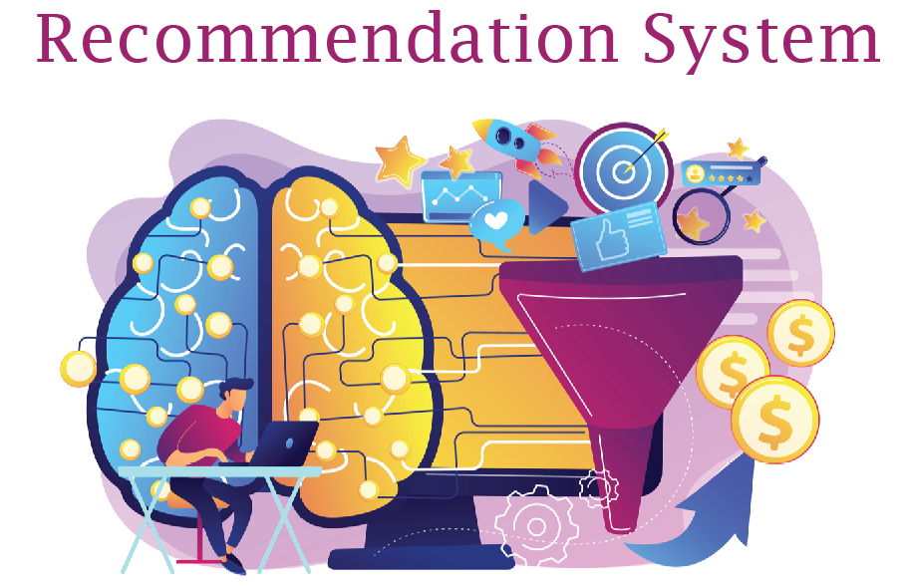

Slide 2
Introduction:
In this project, we are going to explore what is a recommendation system ? its uses, and how we can grow our business with the help of this system ? and then we will build recommendations. A recommendation system is a subclass of Information filtering Systems that seeks to predict the rating or the preference a user might give to an item. In simple words, it is an algorithm that suggests relevant items to users. I am going to build 2 recommendation systems one on the movie dataset and the other one on the product dataset.
Examples of Recommendation systems:
* Movie recommendation system.
* Product recommendation system.
* Books recommendation system.

Slide 3
Business Understanding
Business Perspective:
A recommendation system is used to predict whether a customer will buy any specific product or not based on previous shopping history. We can use recommendations to bring any kind of business to another level. On top of strengthening relationships with your customers, the recommendation engines can provide higher returns to your business as they can help boost engagement opportunities with your products and offer a greater influx of cross-selling opportunities. Netflix, YouTube, Tinder, and Amazon are all examples of recommender systems in use. The systems entice users with relevant suggestions based on the choices they make. Recommender systems can also enhance experiences for News Websites.

Slide 4
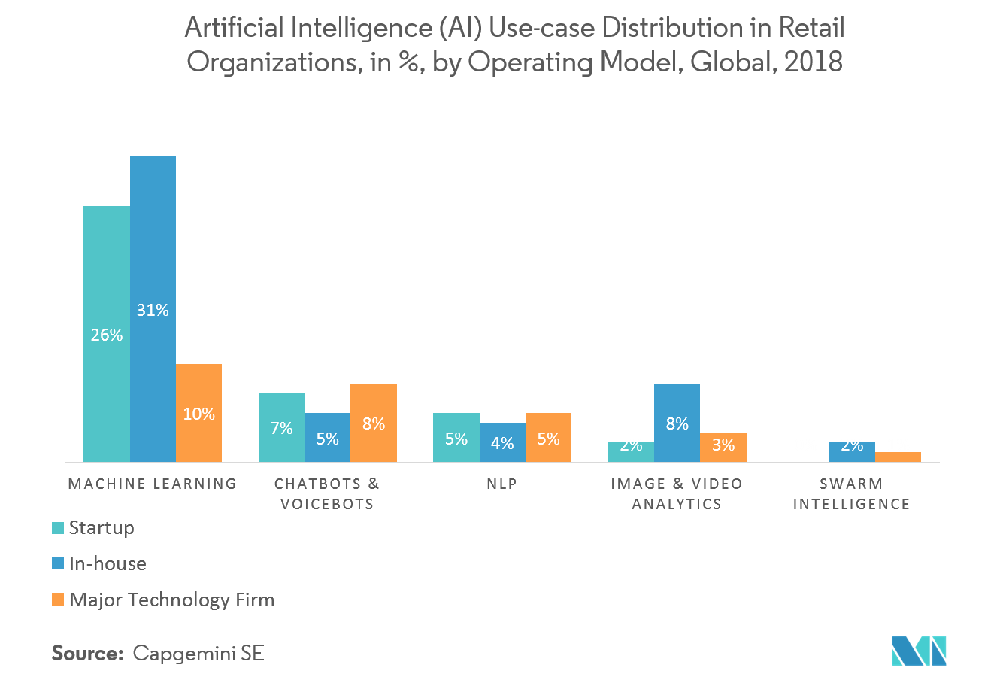
Many businesses take up artificial intelligence (AI) technology to try to reduce operational costs, increase efficiency, grow revenue, and improve customer experience. For the greatest benefits, businesses should look at putting the full range of smart technologies - including machine learning, natural language processing, and more - into their processes and products. However, even businesses that are new to AI can reap major

Slide 5
Some benefits of recommendation system:
Engage Shoppers.
Increase Average Order Value.
Increase the Number of Items per Order.
Convert Shoppers to Customers.
Google Recommendation System:
When you use Google Shopping, you're browsing products from advertisers and sellers who have chosen to feature their products on Google Shopping. Unless otherwise indicated, offers on Google Shopping are ranked based on relevance, including your search terms and other Google activity.
Netflix Recommendation System:
Netflix uses machine learning, a subset of artificial intelligence, to help their algorithms “learn” without human assistance. Machine learning gives the platform the ability to automate millions of decisions based on user activities. Netflix takes feedback from every visit to the website service and continually re-trains our algorithms with those signals to improve the accuracy of their prediction of what we're most likely to watch.

Slide 6
Data understanding
Before we get started, let me define a few terms to describe the datasets:
Item: A thing that is recommended, whether it be a product, movie, webpage, or piece of information.
User: A person who rates items and receives recommendations for new items.
Rating: An expression of preference by a user in regards to items. Ratings can be binary (like/dislike), integer (1 to 5 * stars), or continuous (any value on some interval). Additionally, there are implicit ratings which record only whether a user interacted with an item.

Slide 7
Which datasets I will use in this project?
I am going to use two dataset for recommender system . Movie dataset and amazon review dataset. These dataset does not contains much features and are very clean so no need for detailed preprocessing.
Movies rating dataset features:
1) UserId 2) MovieId 3) Rating (Target column) 4) Title
Products rating dataset features:
1) UserId 2) ProductId 3) Rating (Target column) 4) Timestamp

Slide 8
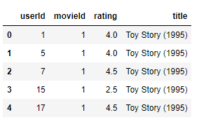
Data Preprocessing
Movie data :
I have a dataset of movies reviews. This dataset contains features. The dataset is pretty so I don't have to do much work for cleaning.

Slide 9
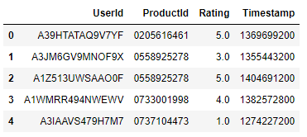
Product data :
For product Recommendation I am going to use the amazon reviews dataset. the dataset contains 4 features but it does not contain the product title feature. we only have got product id. so our recommendation system will only return product id instead of title.

Slide 10
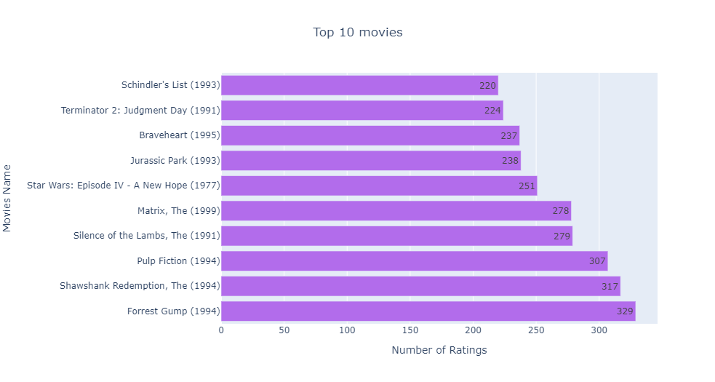
According to the dataset these are the best movies and top rated movies.

Slide 11
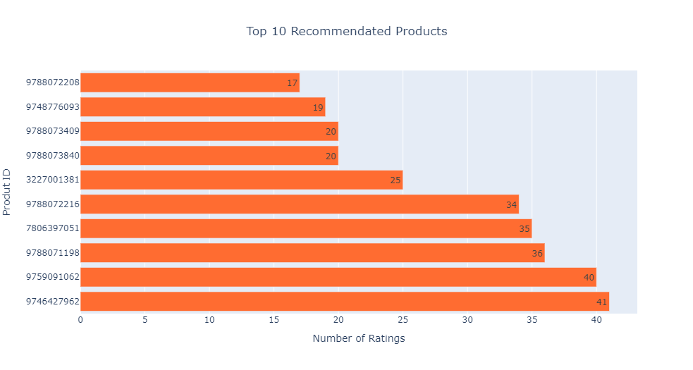
Product:
Eyeliner Pen.
Suggestions:
Kms California Hair Conditioner.
Anti Aging face cream.
Women’s Perfume.
Peanuts: A Charlie Brown Christmas.

Slide 12
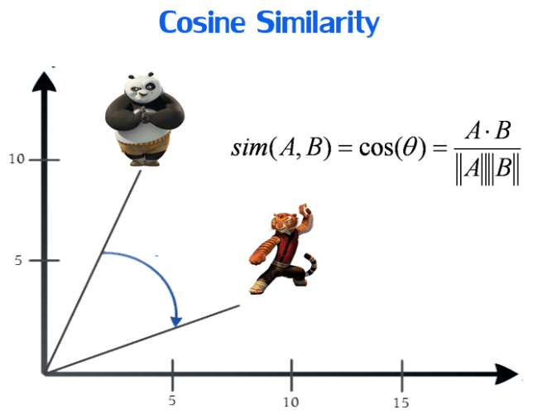
Modeling
Nearest Neighbors:
KNN is a machine learning algorithm to find clusters of similar users based on common book ratings, and make predictions using the average rating of top-k nearest neighbors.
We are going to use the Nearest neighbors to do collaborative filtering. I will use cosine similarity to calculate the distance between the points. Cosine similarity is a metric used to measure how similar two items are. Mathematically, it measures the cosine of the angle between two vectors projected in a multi-dimensional space. The output value ranges from 0–to 1. 0 means no similarity, whereas 1 means that both the items are 100% similar.

Slide 13
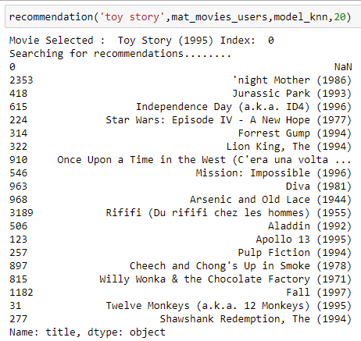
Results of Movie recommendation system:
I have created a function that will take 5 parameters title of the movie, model, number of recommendations, and dataset. I have chosen the title of the toy story. Now you can see the recommendation engine is giving 20 suggestions which closer to the toy story

Slide 14
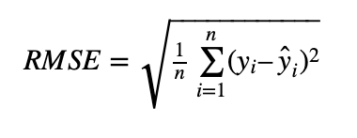
Evaluation
Evaluation Metrics for Recommendation Systems:
Evaluation Metrics Helps to find the Accuracy or Success of Recommender Systems. Predictive accuracy metrics, classification accuracy metrics, rank accuracy metrics, and non-accuracy measurements are the four major types of evaluation metrics for recommender systems.

Slide 15
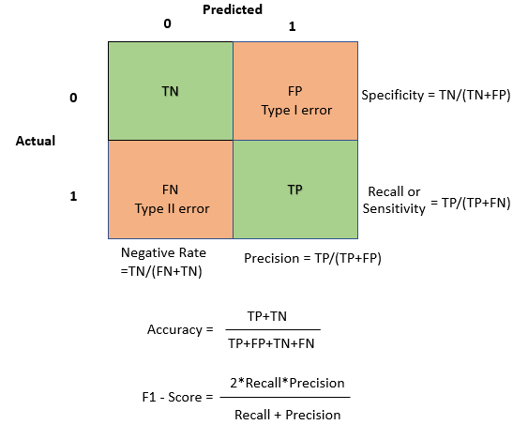
Classification Accuracy Metrics:
Classification accuracy measures attempt to evaluate a recommendation algorithm’s successful decision-making capacity (SDMC). They are useful for user tasks such as identifying nice products since they assess the number of right and wrong classifications as relevant or irrelevant things generated by the recommender system. The exact rating or ranking of objects is ignored by SDMC measures, which simply quantify correct or erroneous classification. This type of measure is particularly well suited to e-commerce systems that attempt to persuade users to take certain actions, such as purchasing products or services.

Slide 16
Deployment
Platforms To Deploy Recommendation Systems
Amazon Sage Maker
Azure Machine Learning
Google Cloud AI Platform
IBM Watson Studio
Heroku
Docker
etc.

Slide 17
Why To Choose Heroku For Testing Recommendation Systems
Deploying a machine learning model as a service can solve most of these problems, and predictions will be real-time. But there will be issues like scalability, monitoring, and down-time of service. Though there are many cloud providers to resolve these issues and provide 24*7 support. Still, if you are a small company or just starting in AI/ML and don’t want to spend more time to handle cloud deployments or DevOps tasks and want a quick deployment option, then deploying your machine learning model on Heroku using Flask will address all your issues. and it is free Cloud Source Platform and very easy to use.
Heroku using Flask
Heroku is a Platform-as-a-Service tool by Salesforce. Heroku is backed by AWS and all Heroku applications/services are hosted on AWS. AWS provides the infrastructure and handles all the load-balancing, resource utilization, networking, logging, monitoring and Heroku acts as a middle-man to provide a scalable, automated rapid deployment platform with all cloud capabilities. Using Flask will provide UI to test and it can be integrated with enterprise-level applications.

Slide 18
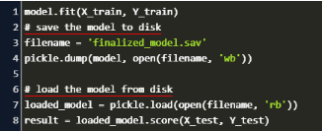
Steps for Recommendation System deployment on Heroku using Flask
Deployment on Heroku using Flask has 7 steps from creating a machine learning model to deployment. These steps are the same for all machine learning models and you can deploy any ML model on Heroku using these steps.
STEP 1:
Create Recommendation ML Model and save (pickle) it

Slide 19
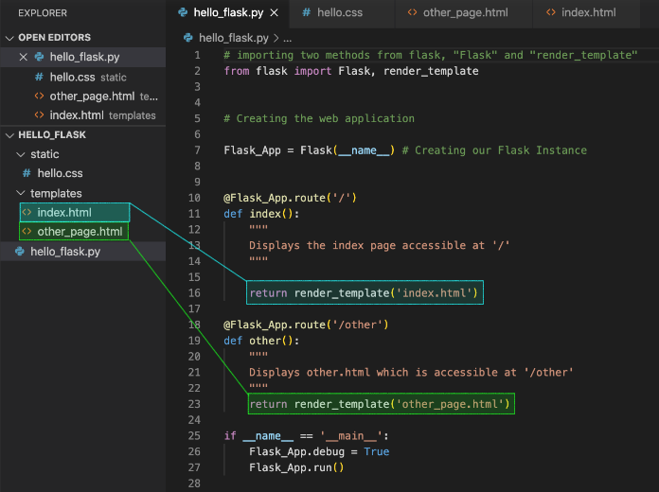
STEP 2:
Create Flask files for UI and python main file (app.py) or with the name of any other .py file
that can unpickle the machine learning model from step 1 and do predictions. we will create flask files — index.html and app.py. index.html, is a flask UI file for providing inputs (or features) to the model. app.py, is a python main file that unpickles the gradient boosting model from Step 1, renders the flask UI page index.html and makes predictions based on input from UI.

Slide 20
STEP 3:Create requirements.txt to setup Flask web app with all python dependencies. In Step 3, we will create requirements.txt to add all of the dependencies for the flask app.
STEP 4:Create Procfile to initiate Flask app command. In Step 4, we will create Procfile to specify the commands that are executed by Heroku app on startup.
STEP 5:Commit files from Step 1, 2, 3 & 4 in the GitHub repo

Slide 21
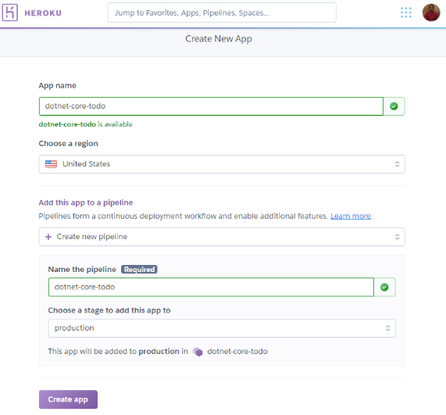
STEP 6:Create account/Login on Heroku, create an app, connect with GitHub repo, and select branch.
In Step 6, we will log in on Heroku and create a new app. Next, we will connect the GitHub repo created in step 5 to the Heroku app and select a branch.
STEP 7:Select manual deploy (or enable Automatic deploys) on Heroku.
Finally in Step 7, select manual (or automatic) deploy and you can see the build logs scrolling. Once the application is deployed, you will get the application URL in logs and it will show the success message.

Slide 22
Conclusion:
We have built two recommendation Systems based on collaborative filtering with the help of Nearest Neighbors. We calculated the items' similarities with the help of cosine similarity. Both models are working great. Most online stores, such as eBay and Amazon, will constantly offer their customers recommendations by sorting through their search results and what they have purchased, This is because a recommendation system is a perfect way to offer a compelling user experience.
By getting to know your customers through content-based approaches, you will ensure that they keep coming back to you. As you learn what does and doesn't sell, you can offer your main target audience exactly what they need. This will quickly lead to more sales and more profit for you!
Benefits of Recommendation System:
Attracts more traffic
Engages shoppers through diversity
Increases customer satisfaction and retention
Boosts conversion rates
Augments upselling and cross-selling efforts
Raises average order value and purchases, and more.

Slide 23
References:
1) https://scholar.harvard.edu/files/sendhil/files/recommenders55.pdf
2) https://ui.adsabs.harvard.edu/abs/2020arXiv201003240C/abstract
3) https://ui.adsabs.harvard.edu/abs/2020arXiv201003240C/abstract

